Slide 1






Complete Preliminary for Schools
Unit 11
The Natural World

Slide 2



Warmer
Tell us about an interesting place you visited

Slide 3

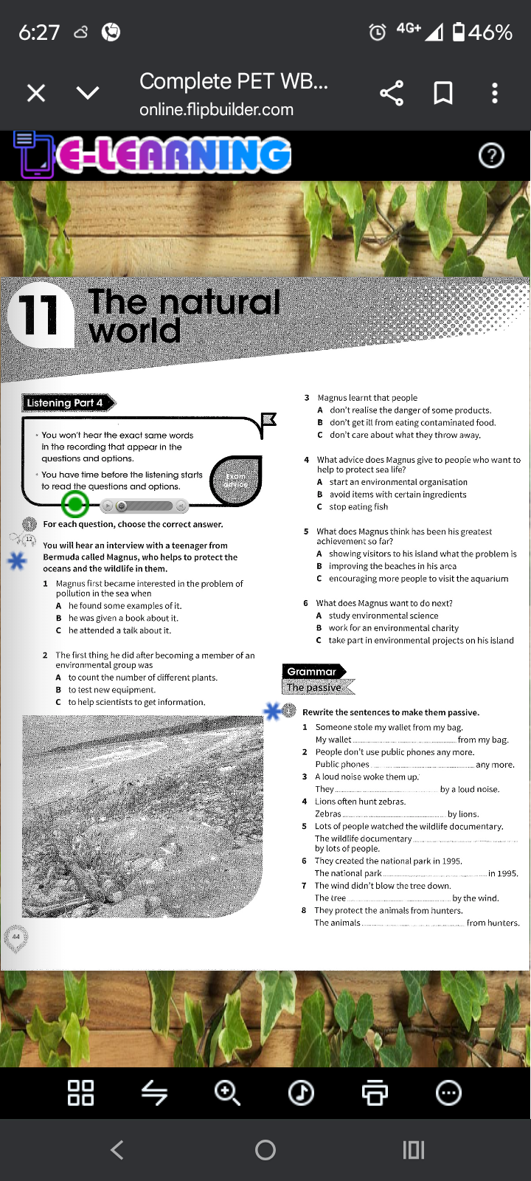


Slide 4


Passive Voice
1. A lot of olive oil is produced in Italy.
2. This book was written by Angela Davis.
3. The suspect will be released tomorrow.
4. This product has not been tested on animals.

Slide 5

Passive Voice
We use the passive voice to change the focus of the sentence.
My bike was stolen. (passive – focus on my bike)
Someone stole my bike. (active – focus on someone)
We often use the passive:
- when we prefer not to mention who or what does the action (for example, it's not known, it's obvious or we don't want to say)
- so that we can start a sentence with the most important or most logical information
- in more formal or scientific writing.

Slide 6

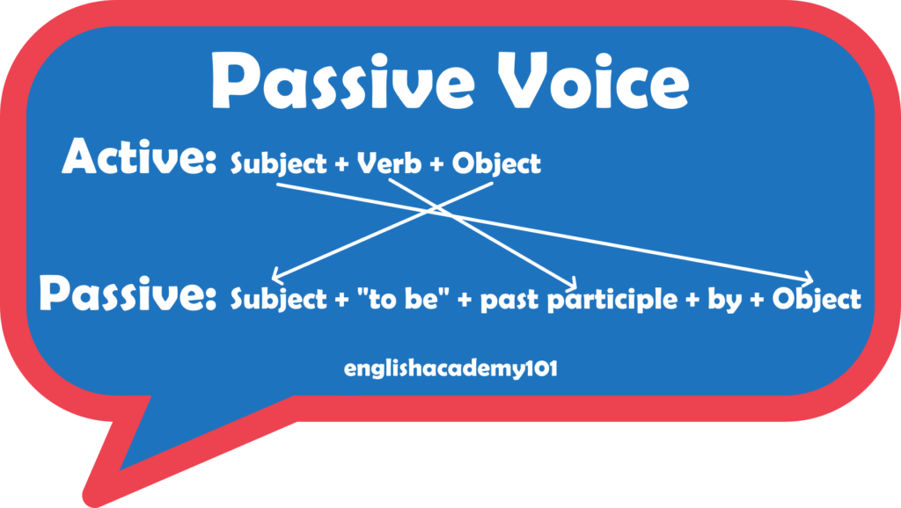

Passive Voice

Slide 7
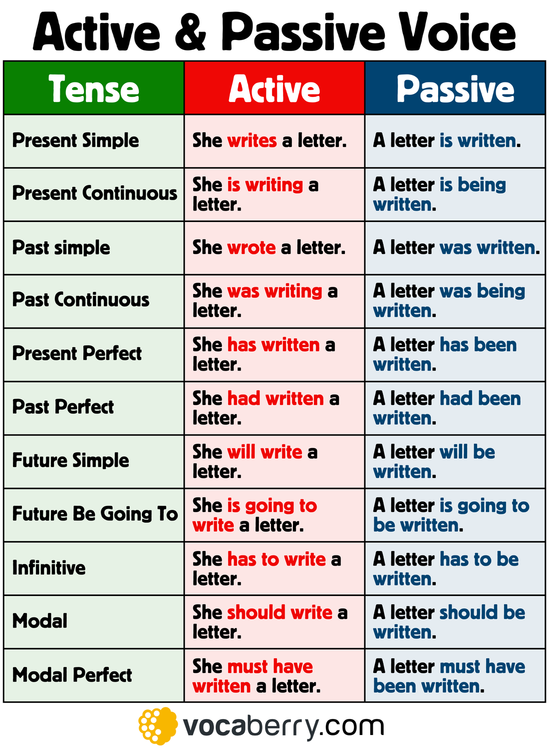

Slide 8

Your Turn

Slide 9
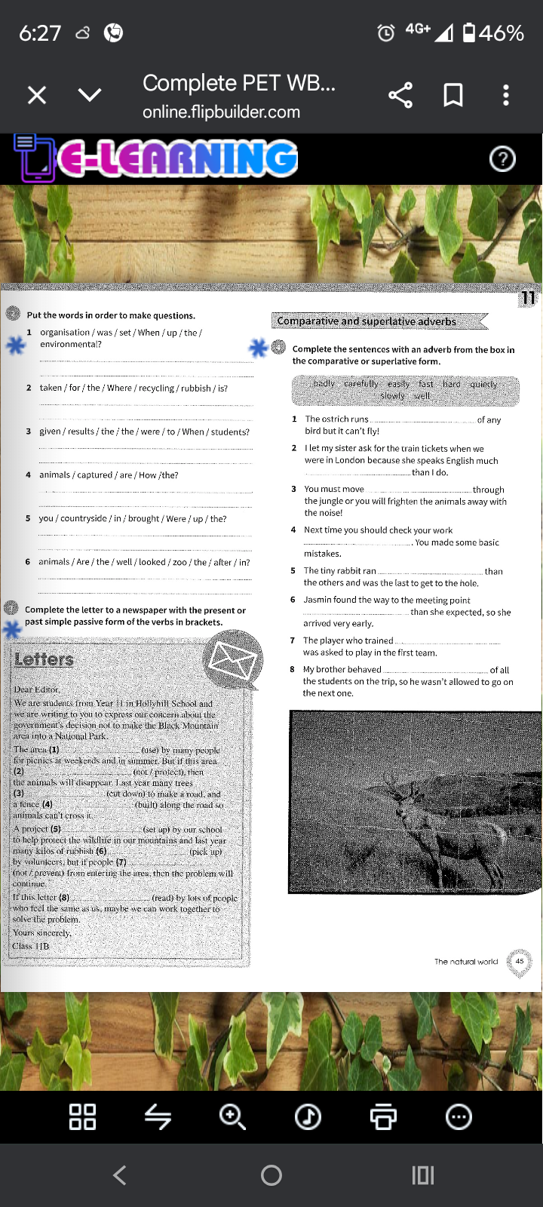

Slide 11
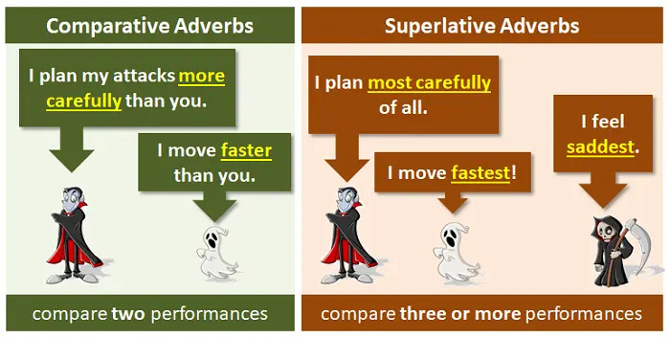
Comparative and Superlative

Slide 12
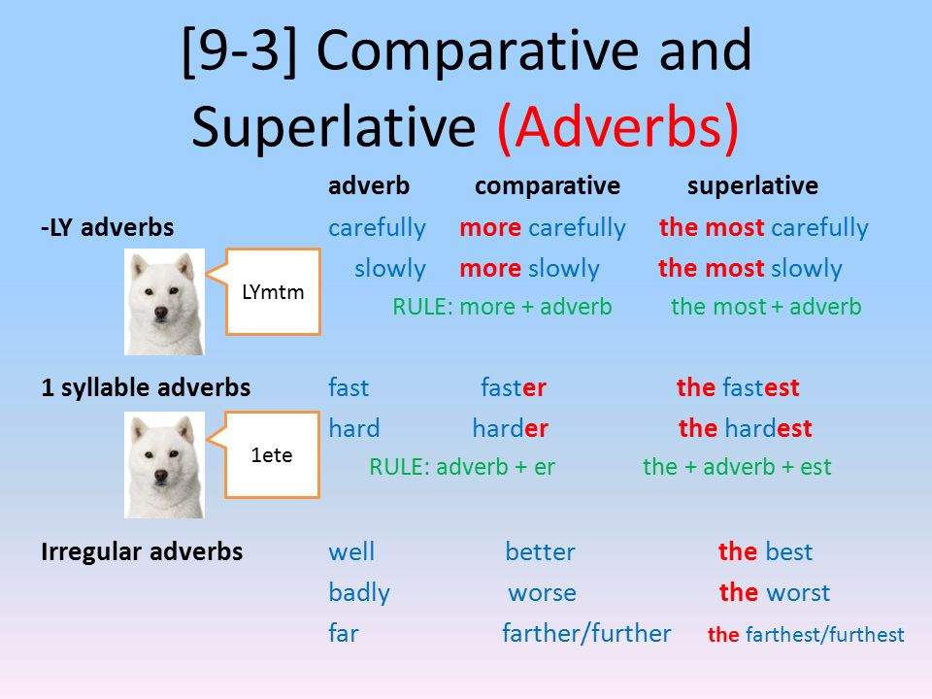

Slide 13
